Slide 1

Inventory Management System
By-
Siddhant Priyadarshi
Digvijay Singh Yadav
Akash Tiwari

Slide 2
Project Analysis
DESCRIPTION
SPECIFICATION
PROJECT
IMPLEMENT
UML DIAGRAMS
TESTING
DEVELOPING

Slide 3
What is inventory Management System?
An inventory management system is the combination of technology (hardware and software) and processes and procedures that oversee the monitoring and maintenance of stocked products, whether those products are company assets, raw materials and supplies, or finished products ready to be sent to vendors or end consumers.
The inventory management system provides a way to store, organize, manage and analyse inventory data.
Systems requirements include: An easy-to-use interface that doesn’t require advanced training, support or documentation.

Slide 4
Aim:
Admin can login to their account.
New products can be added to the Inventory.
Admin can view the products in their inventory.
New orders can be created.
Orders can be viewed, edited or deleted.
Admin can view the statics of their Inventory in the dashboard.
Approach:
The Inventory management system can be helped to view, Edit, Add, create or check orders.
The frontend is created using React.js, HTML and CSS.
For creating database we have used SQL Database.
For our backend we have used Node.js.

Slide 5
Selection of Methodology
This is a small-size project where our requirements are easily understood, therefore we will be following the RAD methodology for our project design and management. Using this methodology, we will be developing the project based on prototyping and iterative development. In RAD model, there is less attention paid to the planning and more priority is given to the development tasks. It targets at developing software in a short span of time, which is exactly what we need for our semester project.

Slide 6
Roles and Methods
● Project Manager – Siddhant Priyadarshi
Will be coordinating across all domains, subdivides tasks among team members, and ensures the quality of the product if of the highest degree possible.
● Business Analyst – Digvijay Singh Yadav
Will be responsible for business strategies which popularize the product in the market. Their job is to come up with innovative ideas to sell the product.
● Marketing Head – Akash Tiwari
In charge of crafting strategies for all marketing teams, including Digital, Advertising, Communications and Creative. Preparing and managing monthly, quarterly and annual budgets for the Marketing department as well as setting, monitoring and reporting on team goals.
● Developers - Siddhant Priyadarshi, Digvijay Singh Yadav, Akash Tiwari.
As it is a team project all the team members will be responsible for creating the code of the project.

Slide 7
PROJECT SCOPE
IN SCOPE
OUT OF SCOPE
It’s a inventory management app.
It will store the database of the products in the store.
Keeps data secure and easily ridable.
Delivery of packages will not be available.
Hosting the frontend and backend server.

Slide 8
Stakeholder Management
Sl. No | Register No | Name | Roles
1 | RA1911031010054 | Siddhant Priyadarshi | Project Manager, Developer
2 | RA1911031010055 | Akash Tiwari | Marketing Head, Developer
3 | RA1911031010051 | Digvijay Singh Yadav | Business Analyst, Developer
4 | SEPM Course Teacher | Nimala K, Srinivas L | Active interest in development of project

Slide 9
Interest and Influence Matrix
Stakeholder Name | Activity / Area / Phase | Interest | Influence | Priority (High / Medium/Low)
Siddhant Priyadarshi | Project Manager, Developer | High | High | High
Digvijay Singh Yadav | Marketing Head, Developer | High | High | High
Akash Tiwari | Business Analyst, Developer | High | High | High
SEPM Course Teacher | Reviewer | Low | High | Medium

Slide 10
REQUIREMENTS
Functional
functional requirement defines a function of a system or its component, where a function is described as a specification of behavior between outputs and inputs.
Non Functional
Nonfunctional Requirements define system attributes such as security, reliability, performance, maintainability, scalability, and usability. They serve as constraints or restrictions on the design of the system across the different backlogs.
Infrastructure Requirements
Infrastructure requirements includes infrastructure needs suchas wharehouse, Systems, Servers, etc.

Slide 11
Major Functions
Registration on inventory.
Generation of unique ID for the particular inventory.
Updating the real time quantity of product and orders in the inventory.
Option to search for the inventory.
Showing Statics of the inventory.

Slide 12
Requirements
User will be able to register and login.
User will be able to search the Inventory.
Users can view the quantity of products in inventory.
Can check the orders and suppliers.
User can request for new order.
User can track their inventory anytime.

Slide 13
Software Requirements
Tech stack (React JS, HTML, CSS, Node.js, SQL)
Designers
Warehouse
Inventory to be tracked
Investors in Our app

Slide 14
Risk Identification
Risk Description | Impact Description
User enters incorrect login credentials then he won’t be able to login. | If this happens then the user can’t access his account.
The addition of new products can take some time. | It can cause some delay.
If user add and orders simultaneously it can effect the database. | User have to wait for it or it will show wrong result.
There may be some issue from server side | If this happens the app can crash.
The database will need a lot of space. If sufficient space is not available then it can cause issues. | If there is insufficient space for the database, then it can cause variations in the results.

Slide 15
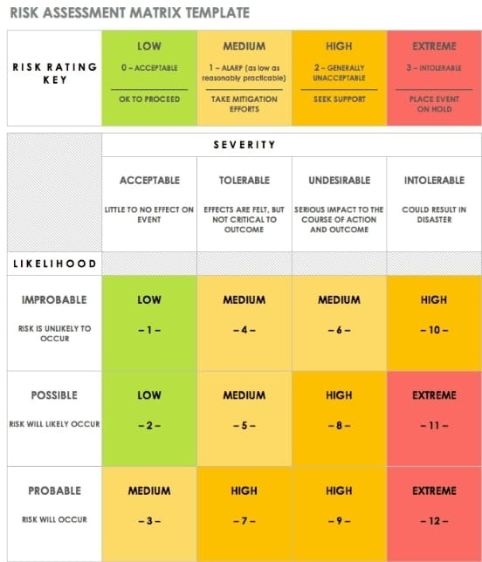
RISK
MANAGEMENT

Slide 16

UML Diagrams

Slide 17
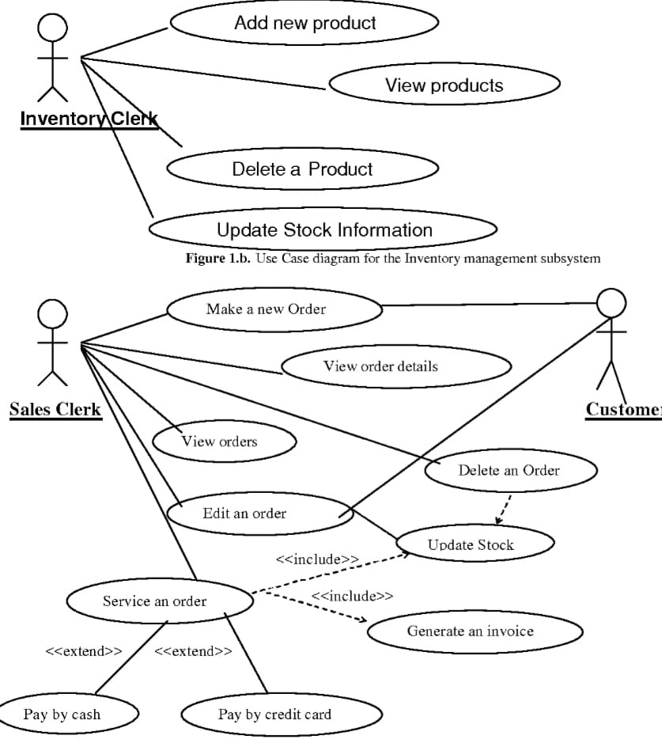
Use Case Diagram
dynamic or behavior diagram in UML. Use case diagrams model the functionality of a system using actors and use cases. Use cases are a set of actions, services, and functions that the system needs to perform. The "actors" are people or entities operating under defined roles within the system.

Slide 18
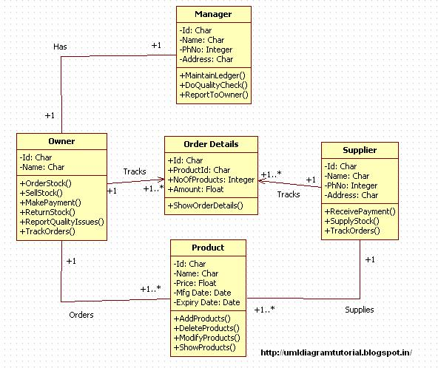
Class Diagram
static structure diagram that describes the structure of a system by showing the System, classes, their attributes, operations (or methods), and the relationships among objects.

Slide 19
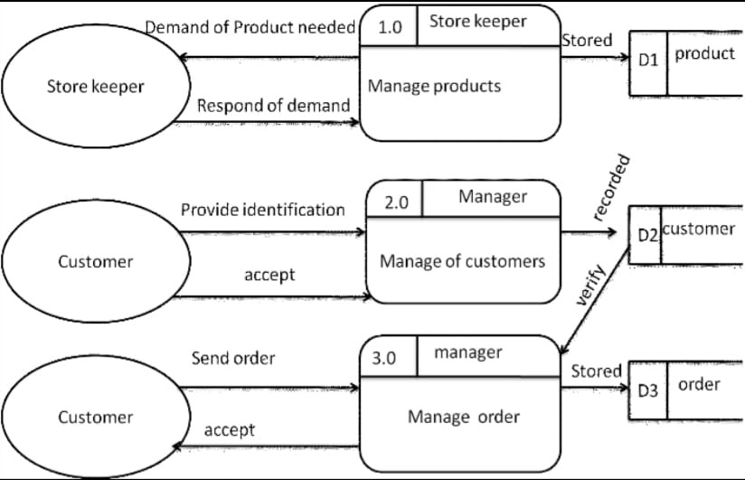
Data Flow Diagram
way of representing a flow of data through a process or a system (usually an information system). The DFD also provides information about the outputs and inputs of each entity and the process itself . When using UML, the activity diagram typically takes over the role of the

Slide 20
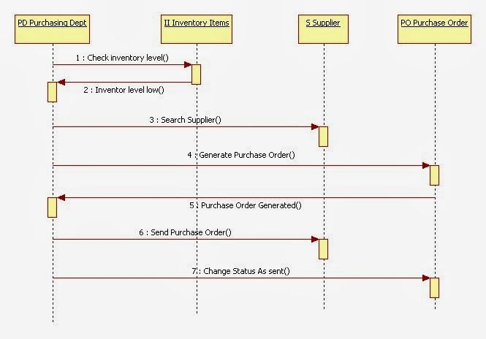
Sequence Diagram
A sequence diagram simply depicts interaction between objects in a sequential order i.e. the order in which these interactions take place

Slide 21
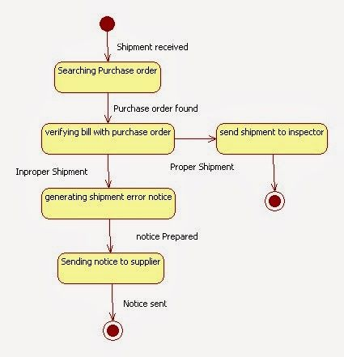
State Diagram
A state diagram is a type of diagram used in computer science and related fields to describe the behavior of systems. State diagrams require that the system described is composed of a finite number of states; sometimes, this is indeed the case, while at other times this is a reasonable abstraction.

Slide 22
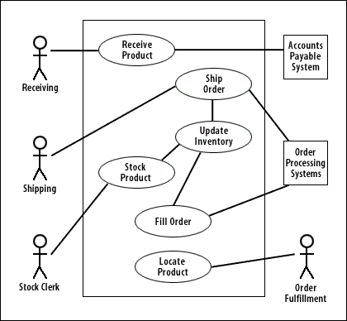
Architecture Diagram
An architectural diagram is a diagram of a system that is used to abstract the overall outline of the software system and the relationships, constraints, and boundaries between components. It is an important tool as it provides an overall view of the physical deployment of the software system and its evolution roadmap.

Slide 23
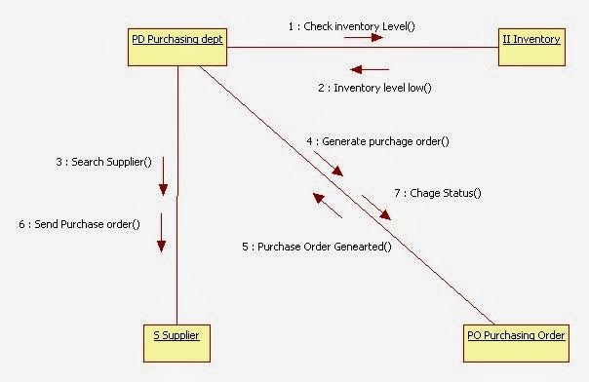
Collaboration Diagram
Collaboration diagrams are used to show how objects interact to perform the behavior of a particular use case, or a part of a use case. Along with sequence diagrams, collaboration is used by designers to define and clarify the roles of the objects that perform a particular flow of events of a use case. They are the primary source of information used to determine class responsibilities and interfaces.

Slide 24
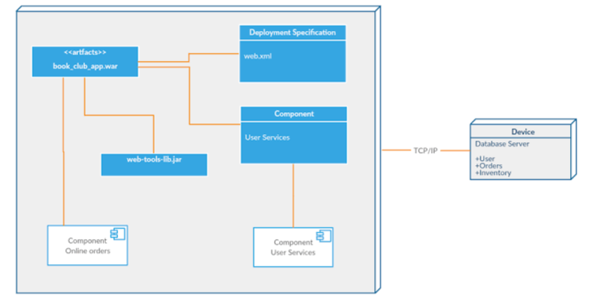
Deployment Diagram
A deployment diagram is a UML diagram type that shows the execution architecture of a system, including nodes such as hardware or software execution environments, and the middleware connecting them.

Slide 25
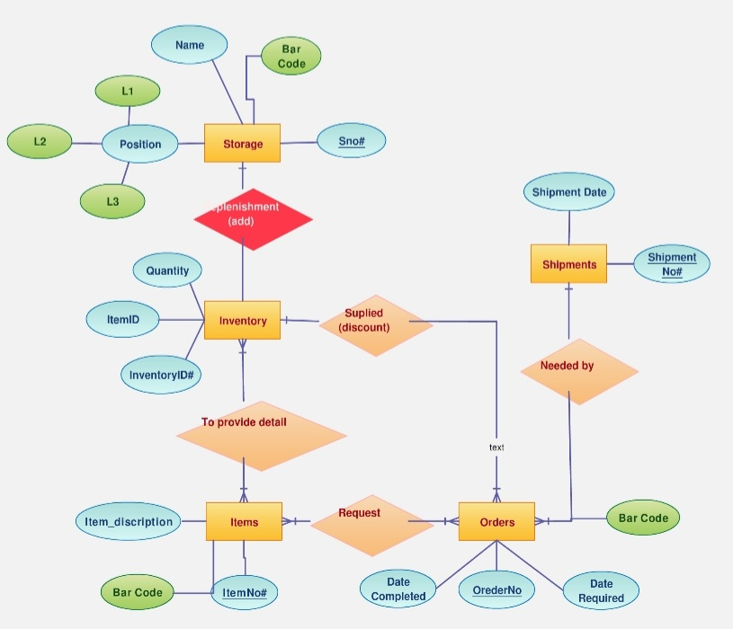
ER Diagram
An entity–relationship model describes interrelated things of interest in a specific domain of knowledge. A basic ER model is composed of entity types and specifies relationships that can exist between entities.

Slide 26

Testing
Testing is one of the most important task of a project. Software Testing is a method to check whether the actual software product matches expected requirements and to ensure that software product is defect free. It involves execution of software/system components using manual or automated tools to evaluate one or more properties of interest. The purpose of software testing is to identify errors, gaps or missing requirements in contrast to actual requirements.
There are two types of testing :-
Functional testing
Non-Functional testing

Slide 27
Functional Testing
The functional testing includes-
User Login
Adding product
Editing product
Deleting product
Checking Orders
Checking Suppliers

Slide 28
Non-Functional Testing
The Non-functional testing includes-
Logging in for first time
Toggle between different pages
Smooth movement of page
Simple UI
Less loading time

Slide 29
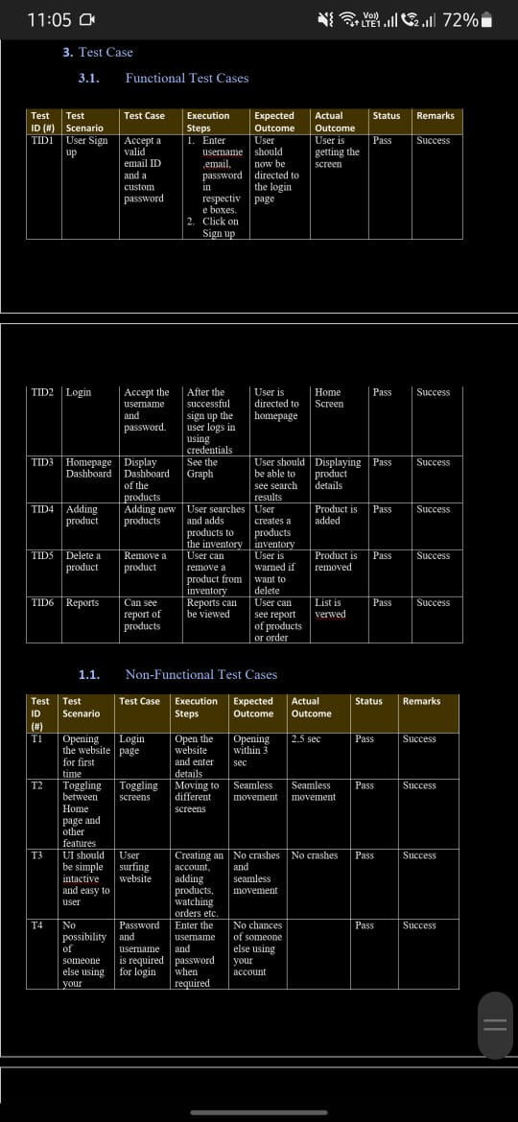

Slide 31
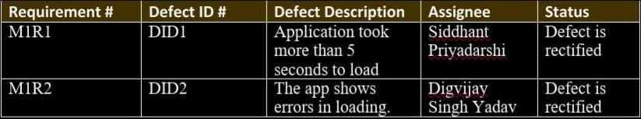
Defect Log

Slide 32
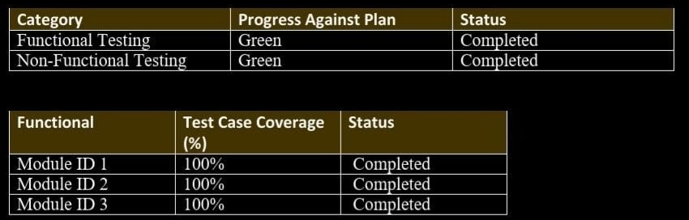
Test Report
Testing was successful. Obstacles were presented to the stakeholders and were further looked into and finally removed.

Slide 33
Code Snippets

Slide 34
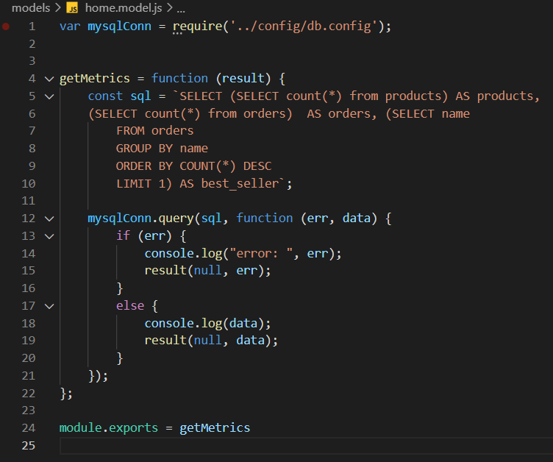
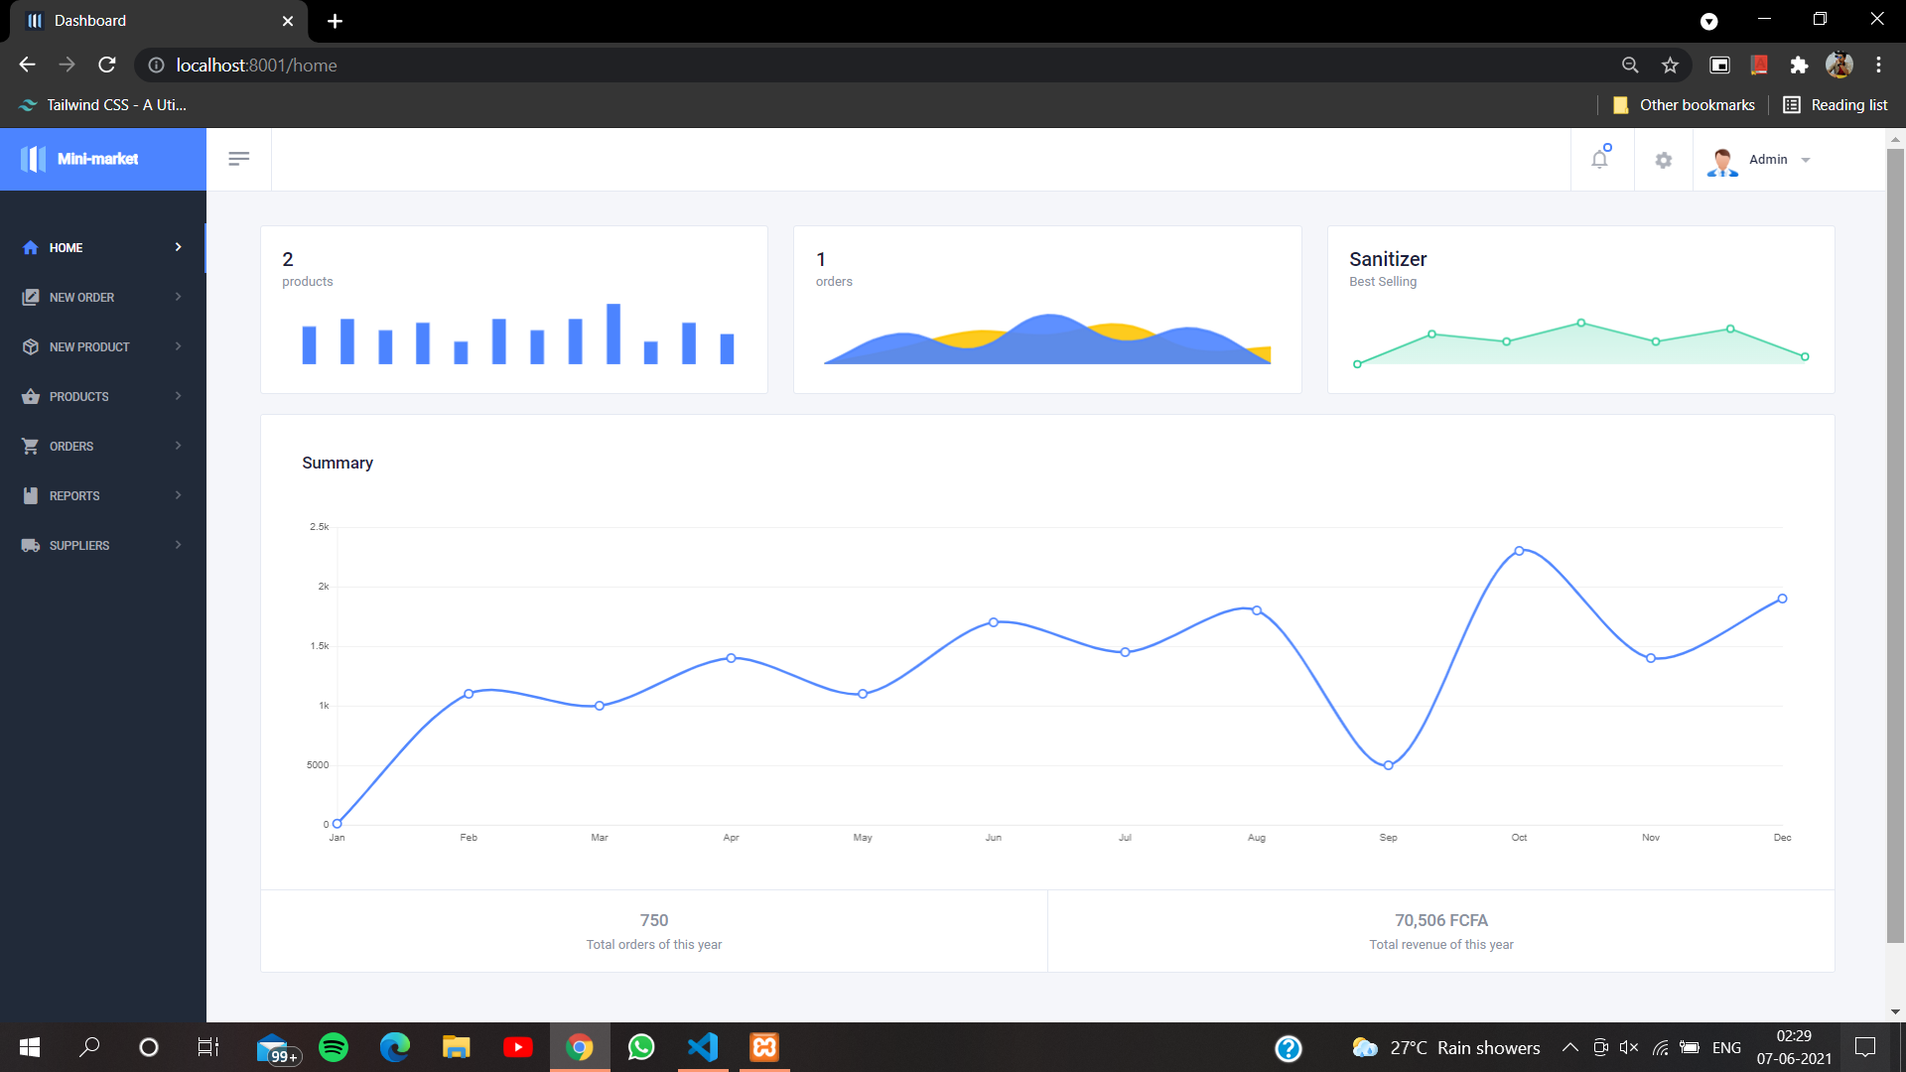
Home Page

Slide 35
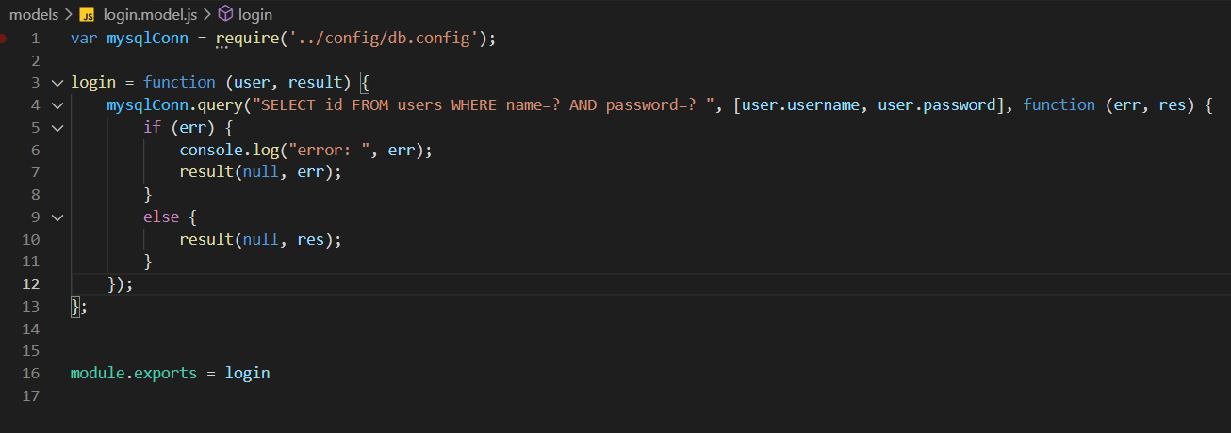
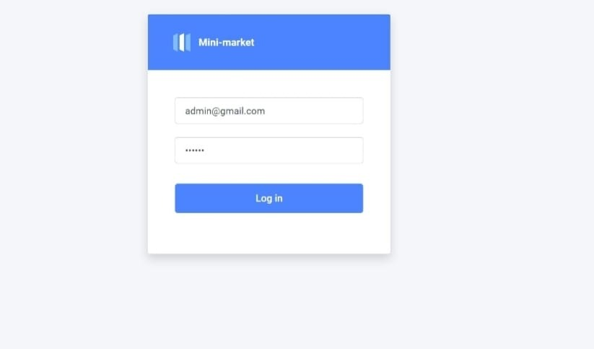
Login Page

Slide 36
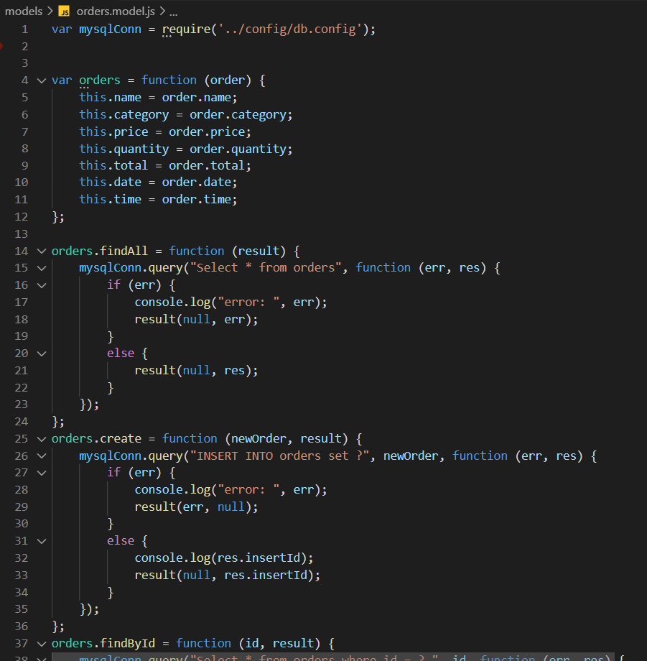
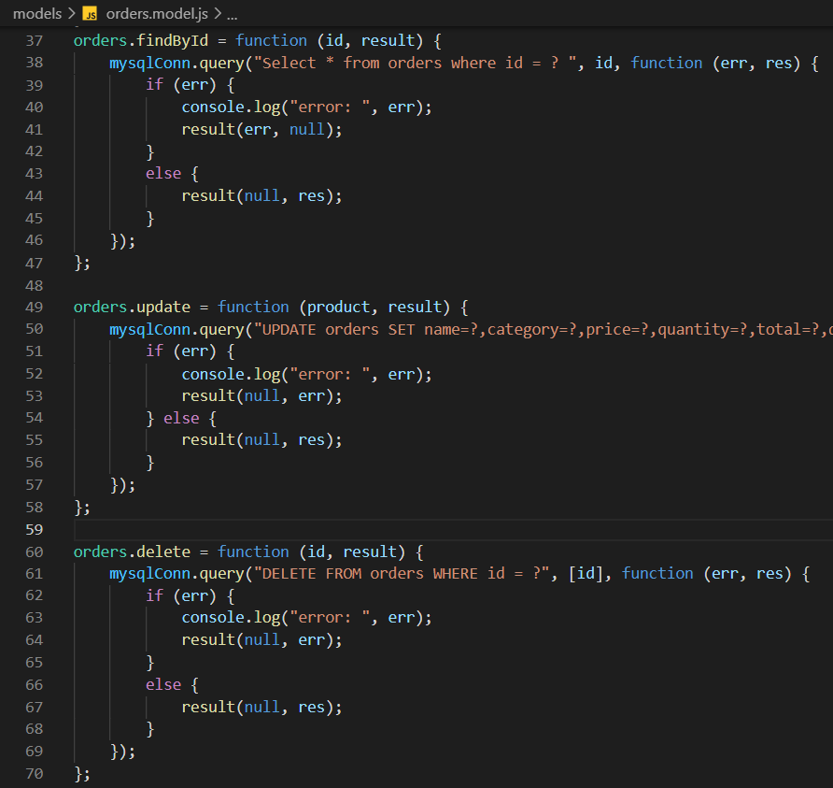
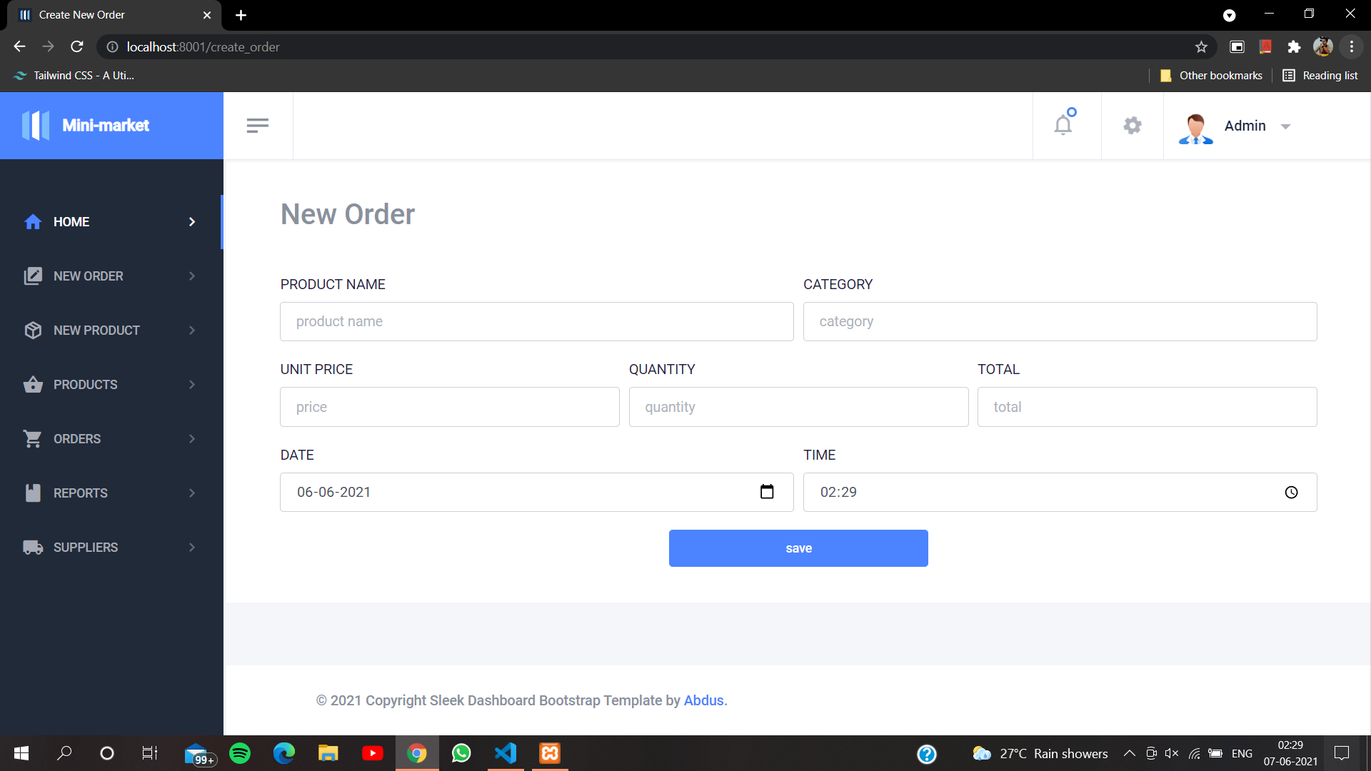
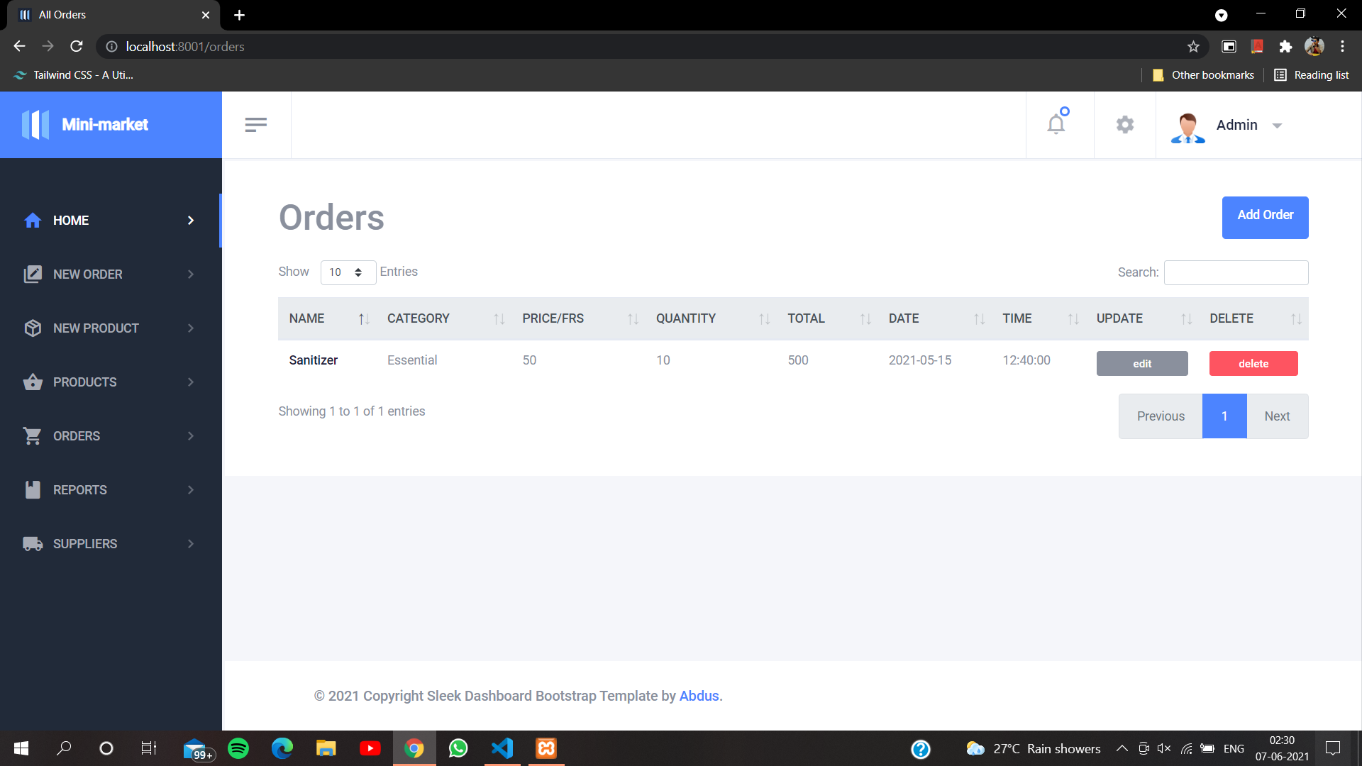
Order page

Slide 37
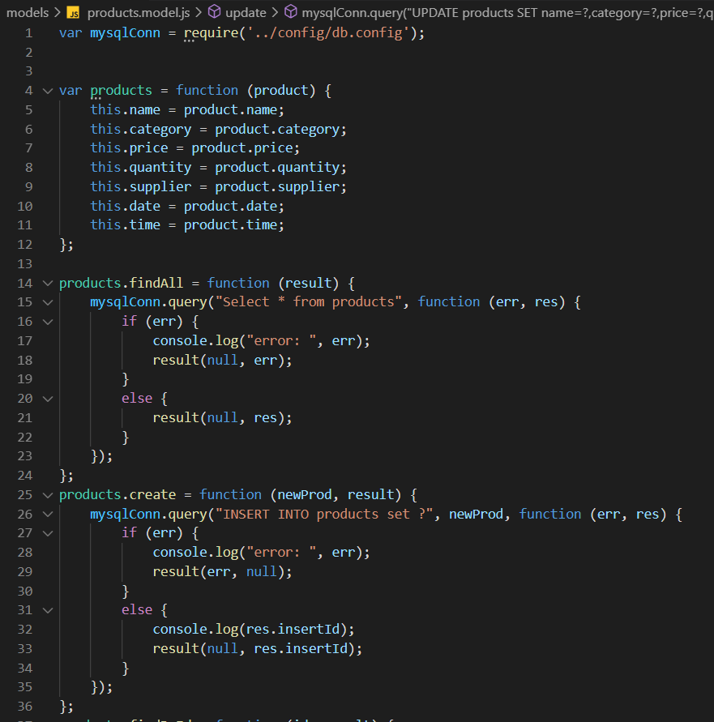
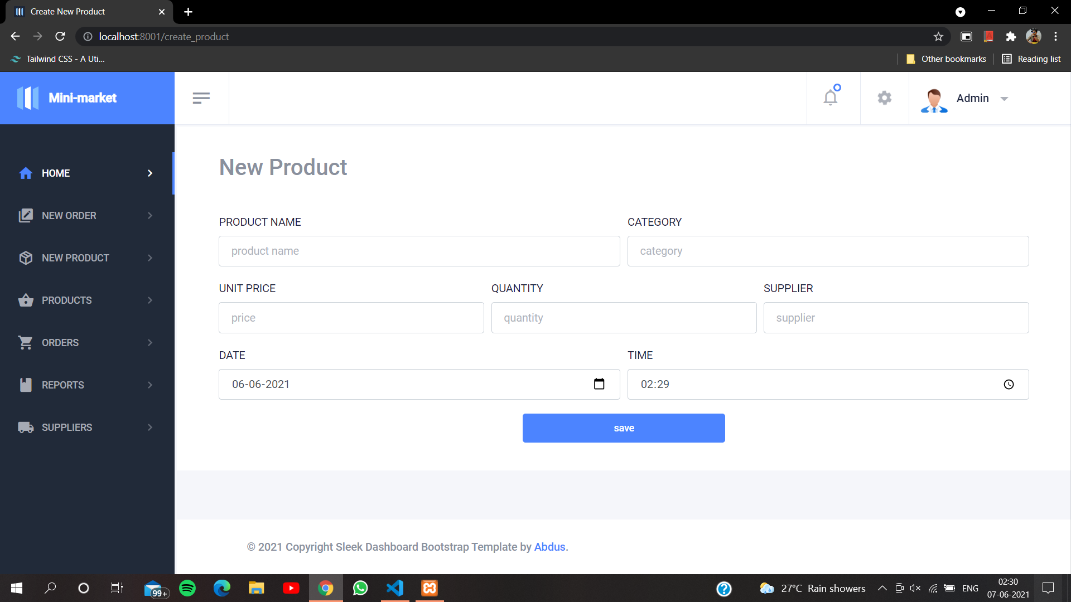
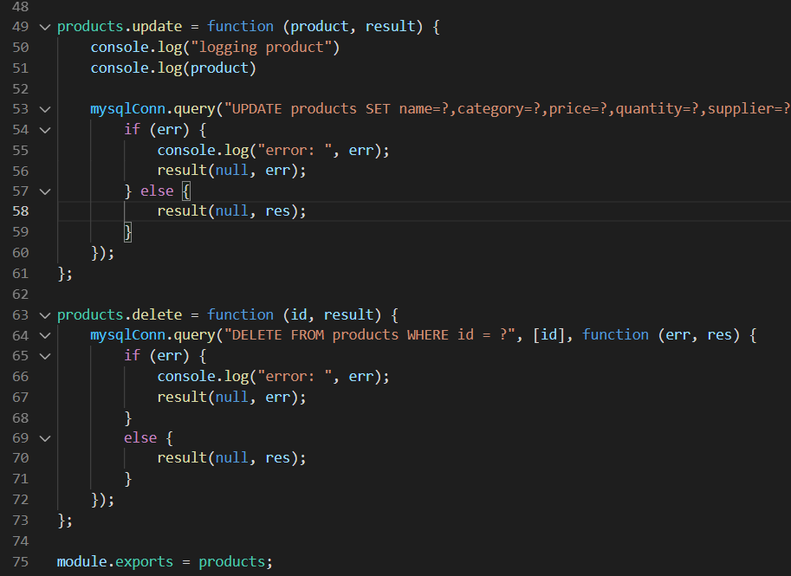
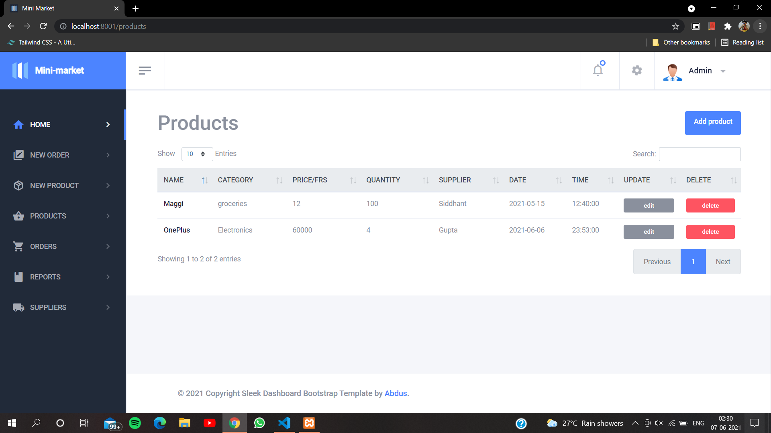

Slide 38
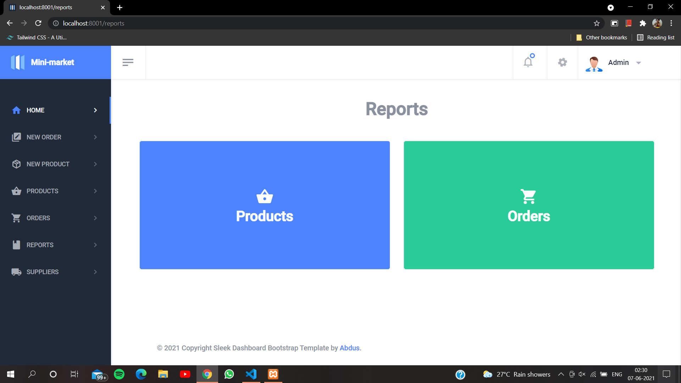
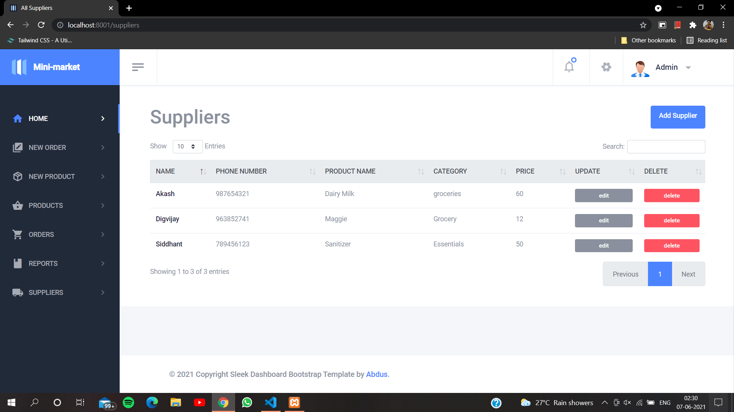

Slide 39


Thank You
நன்றி
*THIS PROJECT WAS DONE KEEPING SOCIAL DISTANCING IN MIND*

